Slide 1
Rethinking Graph Neural Networks for Anomaly Detection
IE 643 Course Project
Team Name: Sic Mundus Creatus Est
Roll Number: 213101002

Slide 2
Outline:
Introduction to Graph Neural Network and motivation
Prediction task and Challenges
Message Parsing Framework & Pooling
Loss function and training
Performance comparison, subsampling
Other graphs
Anomaly Detection

Slide 3
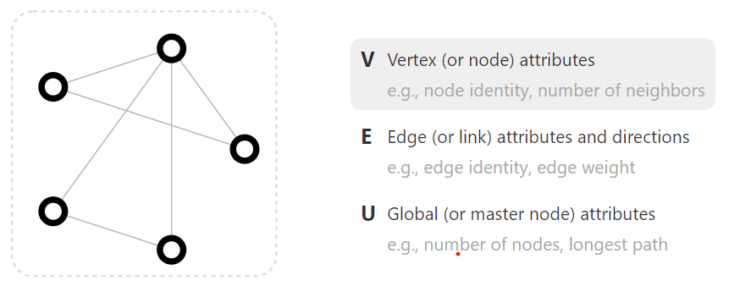
Introduction & Motivation:
Modeling physics systems, learning molecular fingerprints, predicting protein interface, and classifying diseases.
Citation Network, equations, social network, image, texts!

Slide 4
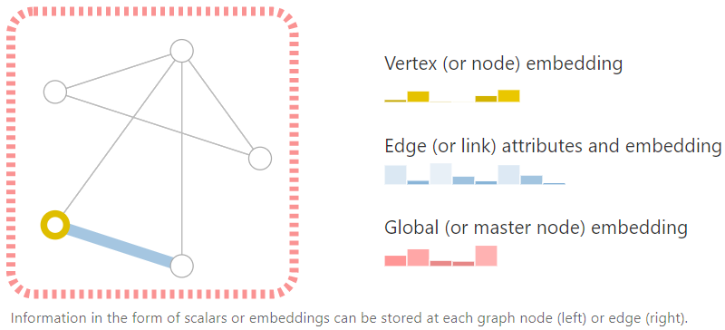
Embeddings:
Information storage!

Slide 5
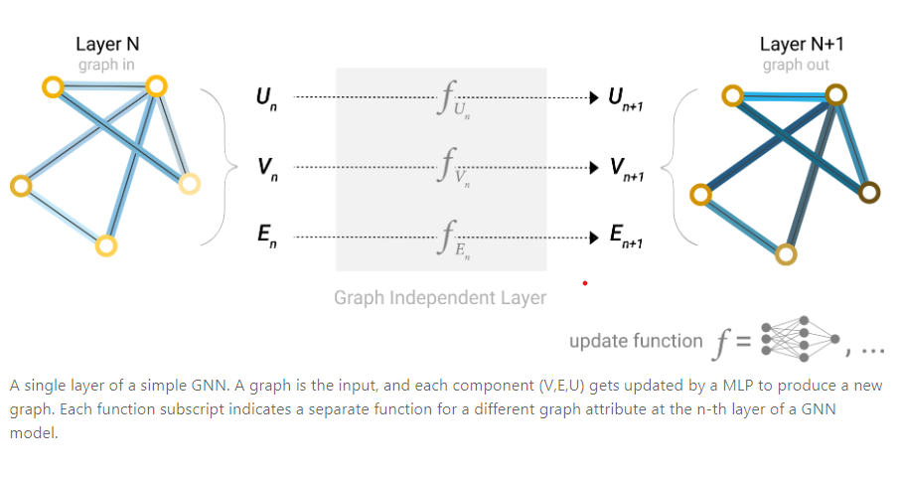
Outline:

Slide 6
Prediction Task:
Graph level task:
  predict the property of an entire graph
  same as image classification (MNIST, CIFAR), sentiment analysis
Edge level task:
  image scene understanding
  value of edge or relationship between nodes
Node level task:
  image segmentation, parts of speech identification
  concerned with predicting the identity or role of each node within a graph

Slide 7

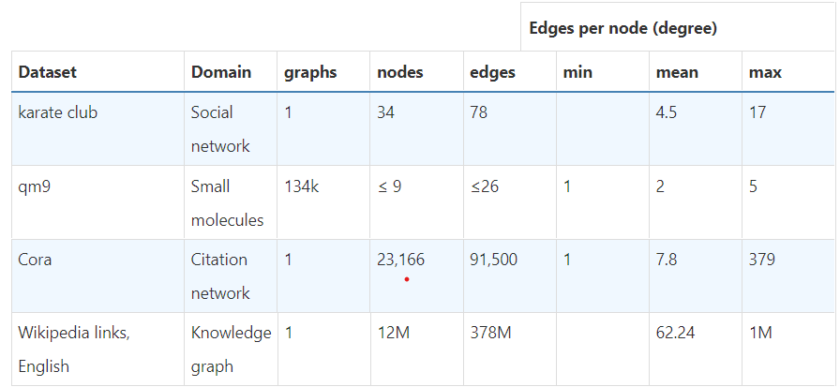
Challenges of using Graphs:
Representation problem (Space, sparseness)
Permutation invariance problem (Neural Network)

Slide 8
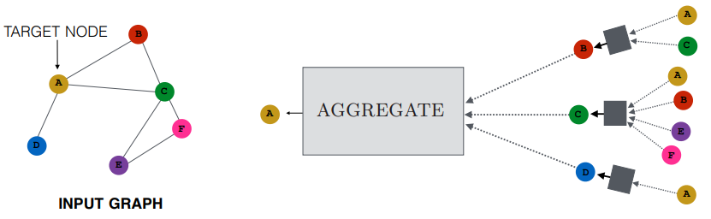
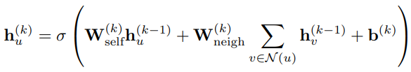
Message Passing:
GNN uses a form of neural message passing in which vector messages are exchanged between nodes and updated using neural networks.

Slide 9
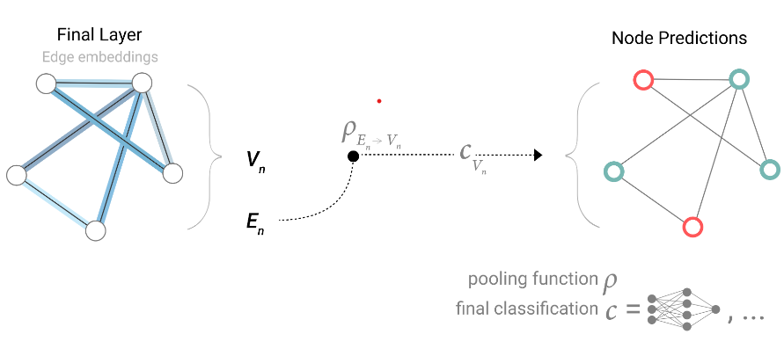
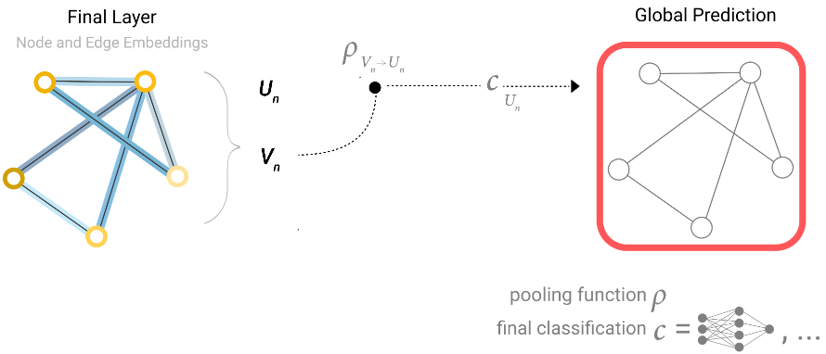
Pooling:
Predicted node-level task from edge level features, for example.
For each item to be pooled, each of their embeddings are gathered and concatenated them into a matrix
The gathered embeddings are then aggregated

Slide 10
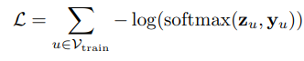

Loss function:
For node classification, loss function is shown below:
Training nodes, transductive test nodes, inductive test nodes
For graph classification, same negative log likelihood but with graph level embeddings
Mean Squared loss function for regression tasks

Slide 11
Performance Comparison:
Higher number of parameters correlates with higher performance.
Sum aggregation is slightly better than max and mean aggregation method.
GNN with a higher number of layers will broadcast information at a higher distance and can risk having their node representations ‘diluted’ from many successive iterations, so more depth is not preferred usually
Idea of subsampling through random node, walk and other methods as usual batch method won’t work

Slide 12
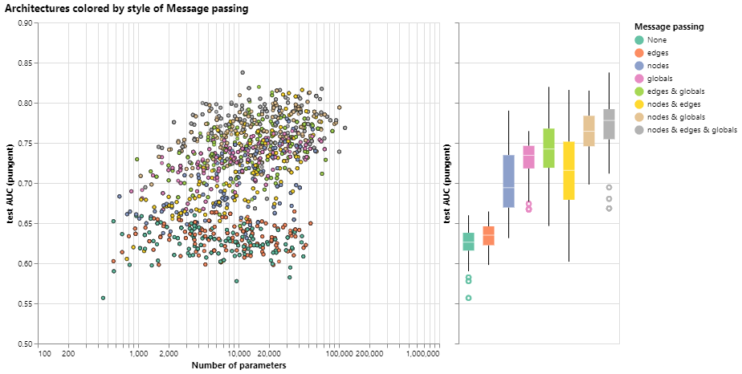

Slide 13
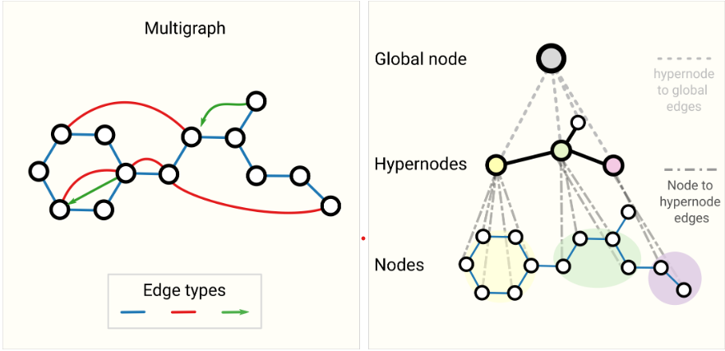
Other types of Graphs:

Slide 14
Anomaly Detection:
An anomaly or an outlier is a data object that deviates significantly from the majority of the objects, as if it was generated by a different mechanism
When GNN aggregates information from the node neighborhoods, it also averages the representations of anomalies and makes them less distinguishable
Three approaches:
  applying attention mechanisms to correlate different neighbors through various views
  using the resampling strategy to aggregate neighborhood information selectively
  designing auxiliary losses to enhance the network training power
BWGNN (Beta Wavelet) uses different wavelet kernels in parallel and then aggregates the corresponding filtering results

Slide 15
References:
https://arxiv.org/ftp/arxiv/papers/1812/1812.08434.pdf
https://distill.pub/2021/gnn-intro/
https://distill.pub/2021/understanding-gnns/
https://www.cs.mcgill.ca/~wlh/grl_book/files/GRL_Book-Chapter_5-GNNs.pdf
https://www.cs.mcgill.ca/~wlh/grl_book/files/GRL_Book-Chapter_6-GNNs_in_Practice.pdf
https://arxiv.org/pdf/2205.15508.pdf

